Slide 1


BUSINESS GROWTH AND REVENUE FORECAST
MRADU SINGH KUSHWAH VANSHIKA SHARMA

Slide 2
BUSINESS PROBLEM
The company deals in supplies of printers such as ink, core etc.
They wish to see where there business is headed in the coming year and the growth/ de-growth they can expect in the next year.
OUR CHALLENGES
Our task is to find out factors which are significantly contributing to the revenue and forecast the revenue for the next year based on previous years.
We will perform an exploratory data analysis and try to find patterns and insights from the given data and based on that predict future revenue using time series analysis.
We will try to analyze which customer groups , sales group and product category should be targeted in order to increase the revenue for the company.

Slide 3
OUR APPROACH
BUSINESS UNDERSTANDING
DATA CLEANING
EXPLORATORY ANALYSIS OF DATA
TIME SERIES ANALYSIS & FORECASTING
SOLUTIONS

Slide 4
DATA OVERVIEW
TOTAL CUSTOMERS
626.3K
PURCHASES
2m
REVENUE GENERATED
229.8m

Slide 5
PRODUCT CATEGORIES
Ink
Toner
SALES GROUPS
Direct Sales
Inside sales
CUSTOMER GROUPS
Commercial
State government
Others
ISA
Web
Supply
Partners
SSI
Core
Non Profits
Local Government
Independent Dealers
Dealers
Federal Government
Strategic

Slide 6
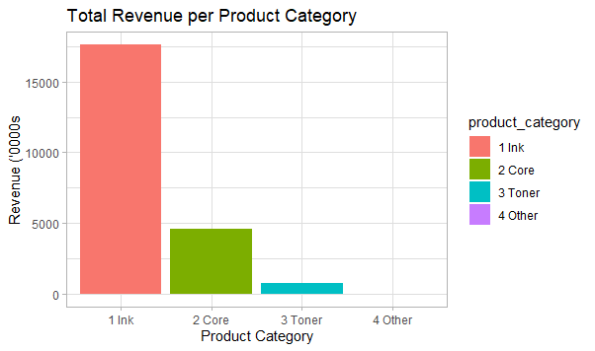
CONTRIBUTION TO REVENUE(PRODUCT CATEGORY)
INK
TONER
OTHER
CORE
76.7%
20.0%
3.29%
0.004%
From EDA we found that the contribution of Ink and Core to the revenue over the time period(2016-19) is high (76.7% and 20.0% respectively) as compared to toner and other(3.29% and 0.004% respectively).

Slide 7
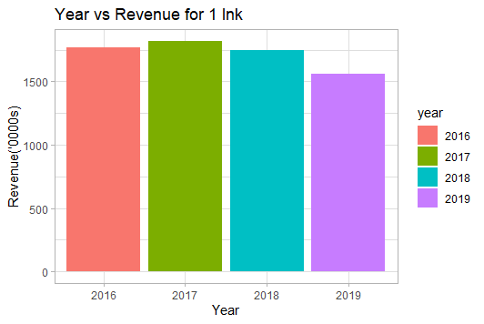
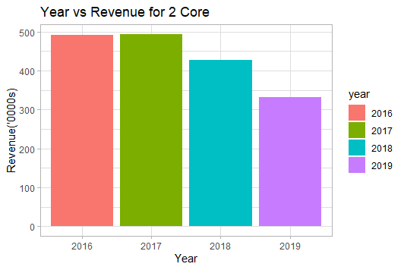
TOTAL REVENUE FROM EACH PRODUCT (YEARWISE)
On comparing the revenue from Ink and core in four months (April-July) for every year, we can see that there is a decrease in revenue from ink and core in 2019.

Slide 8
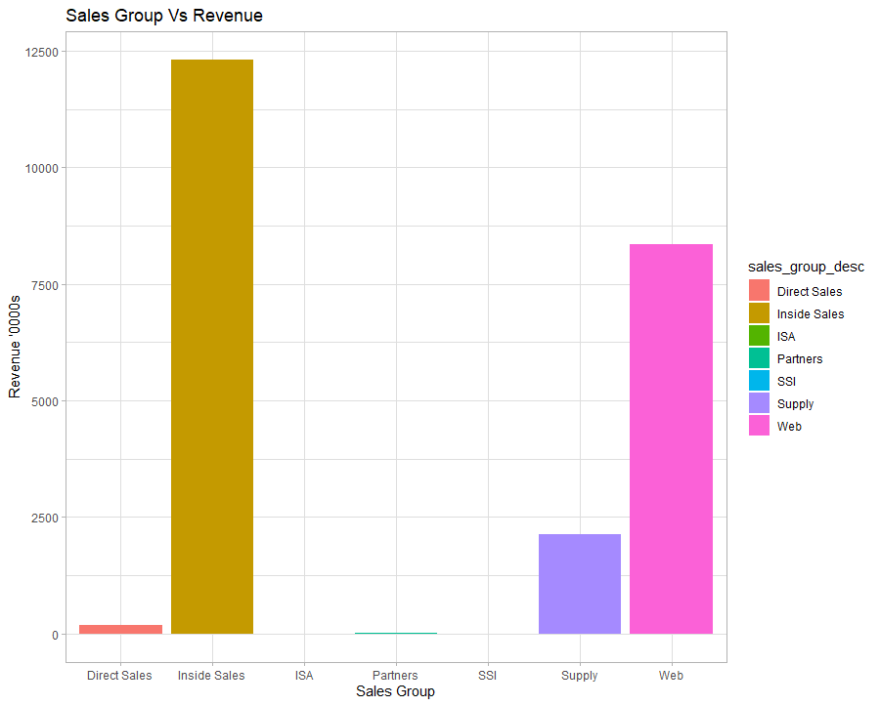
CONTRIBUTION TO REVENUE(SALES GROUP)
DIRECT SALES
SUPPLY
WEB
PARTNERS
I ISA
SSI
INSIDE SALES
0.78%
53.6%
0.0%
0.02%
0.003%
9.29%
36.36%
We can see that maximum amount of revenue during April 2016-July 19 is generated by Inside sales and web (53.6% and 36.36% of the total respectively) followed by supply which generates 9.29% of the total revenue.

Slide 9
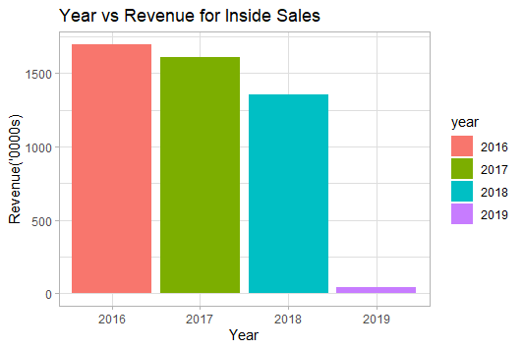
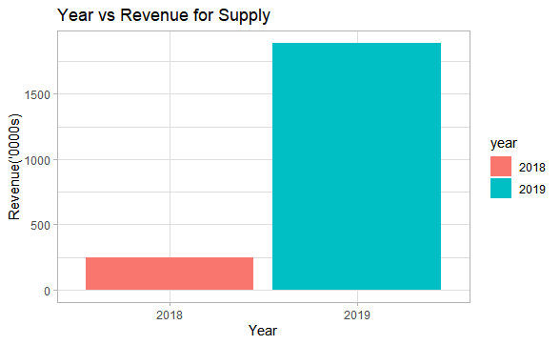
TOTAL REVENUE FROM EACH SALES GROUP (YEARWISE)
INSIDE SALES
SUPPLY
On comparing the revenue from Inside sales in four months (April-July) for every year, we can see that there is a decrease in revenue generated through inside sales in 2019.
We can see that there is an increase in revenue generated through supply in 2019 as compared to 2018.

Slide 10
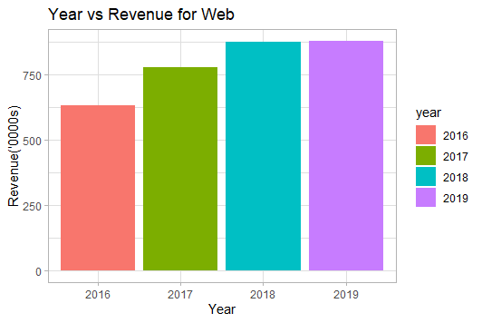
TOTAL REVENUE FROM EACH SALES GROUP (YEARWISE)
TOTAL REVENUE FROM EACH SALES GROUP (YEARWISE)
WEB
On comparing the revenue from Web in four months (april-july) for every year, we can see that there is an increase in revenue generated through Web in 2019.

Slide 11
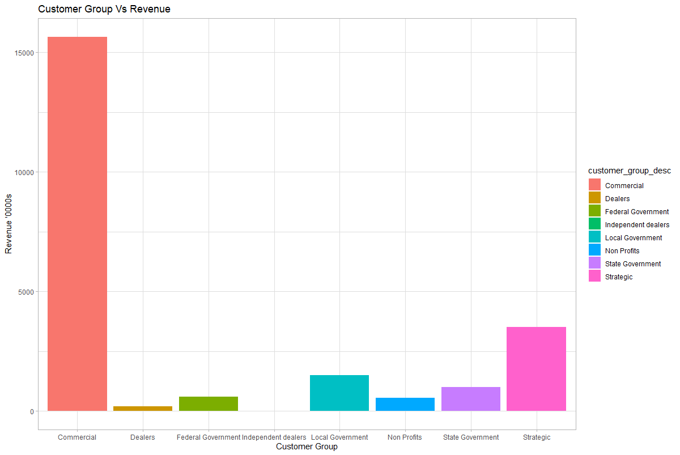
CONTRIBUTION TO REVENUE(CUSTOMER GROUP)
COMMERCIAL
STATE GOVERNMENT
STRATEGIC
LOCAL GOVERNMENT
I FEDERAL GOVERNMENT
NON PROFITS
DEALERS
68.09%
0.851%
2.546%
6.517%
2.36%
4.334%
15.3%
We can see that maximum amount of revenue generated during April 2016-July 2019 is by Commercial and Strategic customer groups(68.09% and 15.3% of the total revenue respectively).

Slide 12
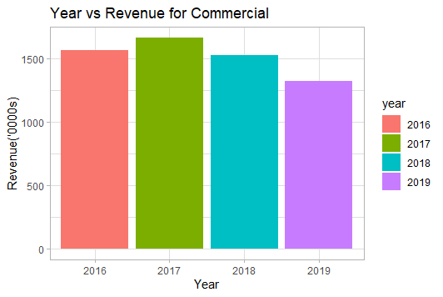
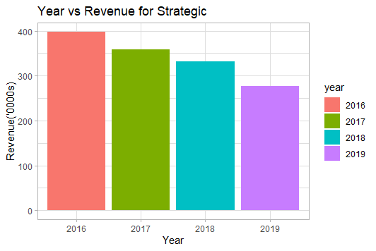
TOTAL REVENUE FROM EACH CUSTOMER GROUP(YEARWISE)
COMMERCIAL
STRATEGIC
On comparing the revenue generated from Commercial and Strategic in four months (April-July) for every year, we can see that there is a decrease in revenue generated through Commercial and Strategic customer groups in 2019.

Slide 13
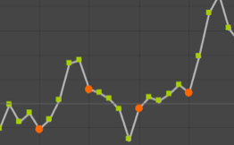
WHAT IS A TIME SERIES?
Time Series
Seasonal
Trend
Random
Cyclic
Is there a variation in data due to seasonal factors?
Series of values of a quantity obtained at successive equally spaced points in time.
Is there a growth or decline in a time series?
Is there a long term oscillation in data?
Is the data effected by some sudden movements unlikely to be repeated?

Slide 14
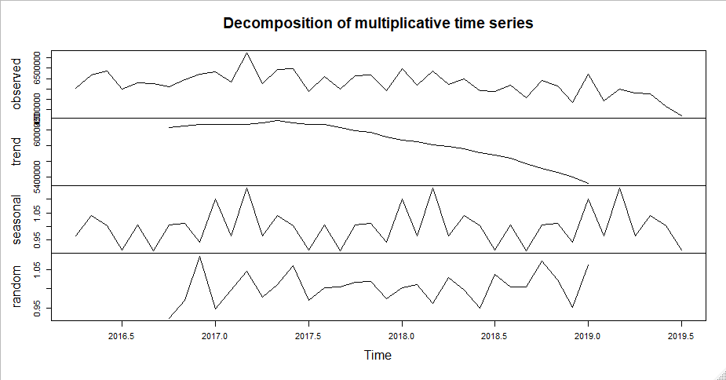
Exponential Smoothing
When to use?
Which order to use?
TECHNIQUE USED
When the data doesn’t have a clear pattern.
First order gives less weight to past observations and more weight to recent observations.
Second order deals with the trends in data.
Third order deals with the seasonality in data.
FORECASTING
Forecasting involves taking models fit on historical data and using them to predict future observations

Slide 15
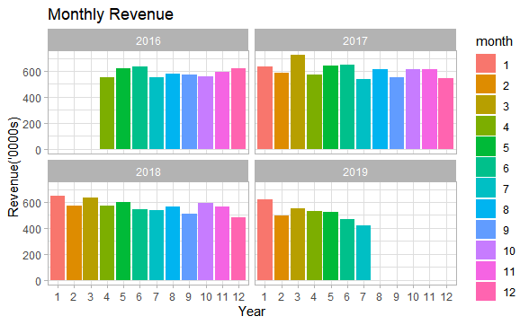
TIME SERIES ANALYSIS FOR FORECASTING GROWTH OR DEGROWTH
The data starts from April 2016 and ends at July 2019.
A decline in revenue can be seen in the later months of 2019 but we want to be certain if it is just a seasonal effect or the revenue is really decreasing this year.

Slide 16
2019 DATA VS 2019 FORECASTS
Original Data
Data with forecast for 2019
The plots show that there was a decrease in revenue beforehand.

Slide 17
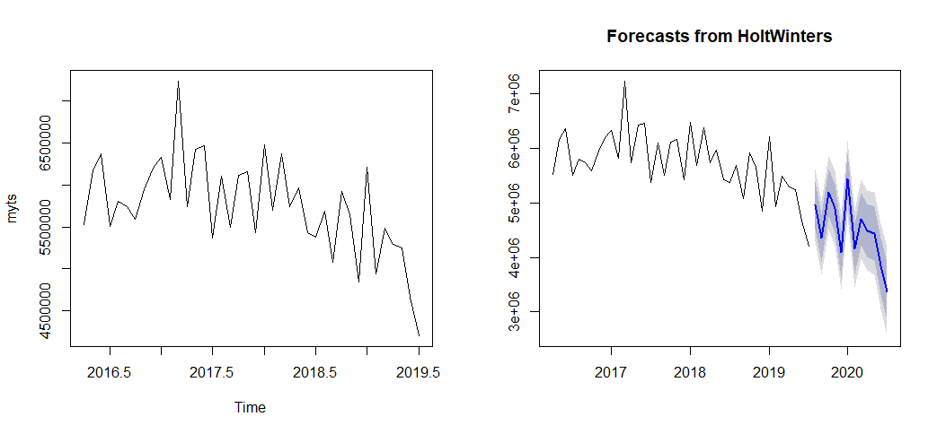

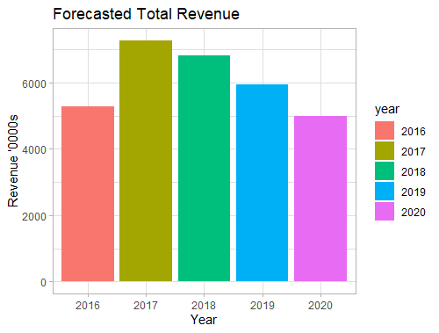
FORECASTS OF TOTAL REVENUE
Decrease in total revenue can be seen.
Forecasted Average monthly Revenue(Aug 19-Dec 20):4.3m

Slide 18
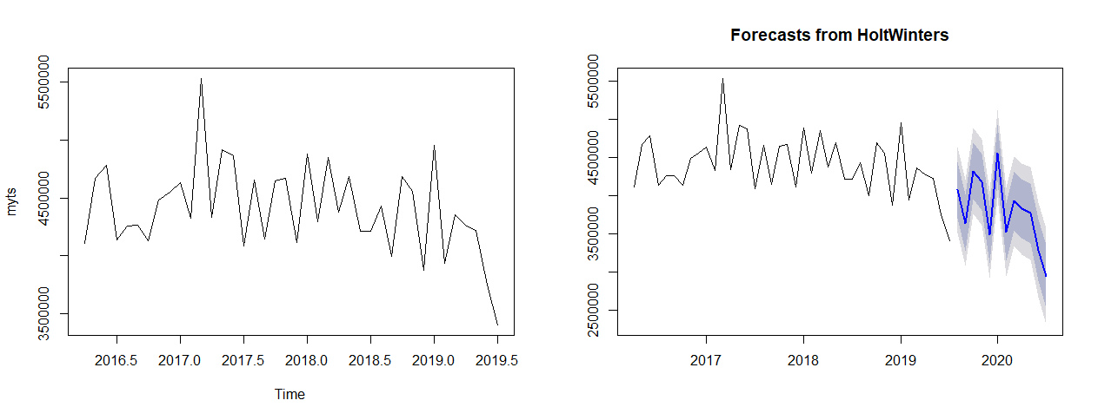
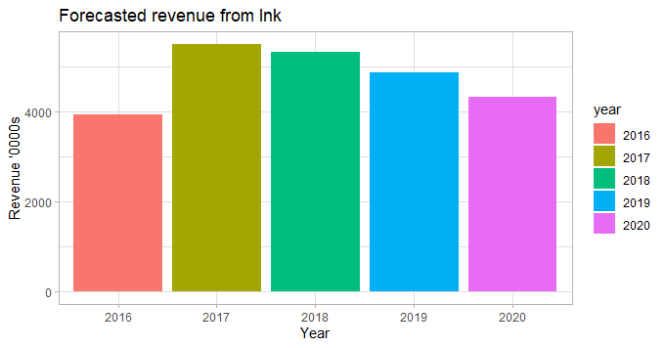
FORECASTS OF REVENUE FROM INK
The revenue from inks are also decreasing.
Forecasted Average monthly Revenue(Aug 19-Dec 20):3.6m

Slide 19
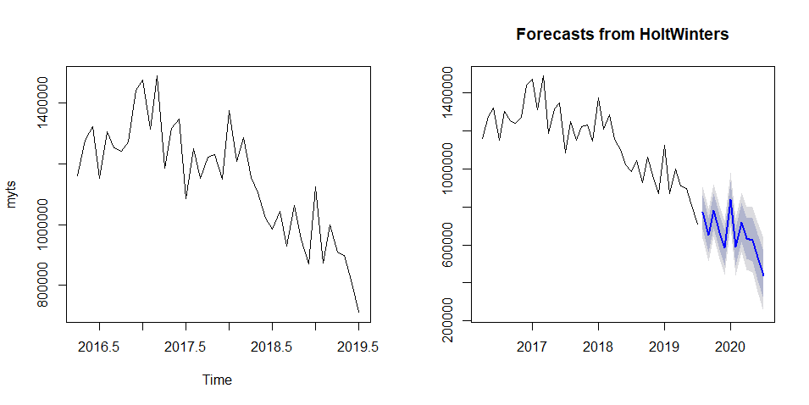
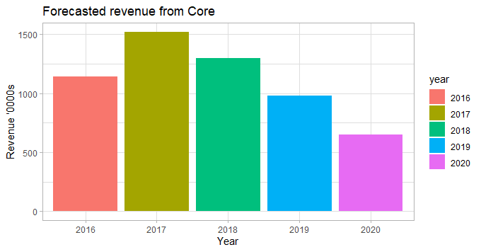
FORECASTS OF REVENUE FROM CORE
There is a more significant drop in revenues from Core sales.
Forecasted average monthly Revenue(Aug 19-Dec 20):0.58m
Forecasted

Slide 20
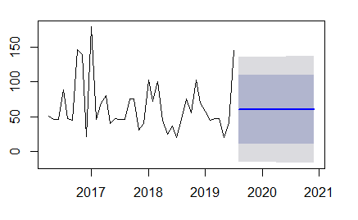
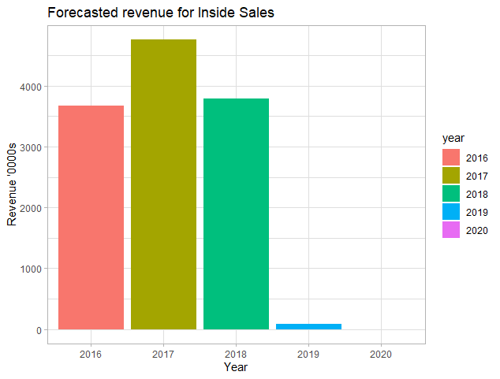
FORECASTS OF REVENUE FROM INSIDE SALES
Inside Sales showed the most drastic drop and the forecasts of revenue for the coming year is negligible.

Slide 21
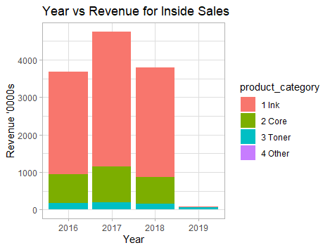
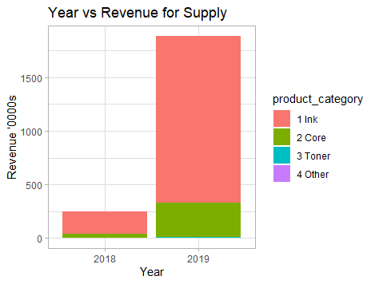
REASONS?
The marketing channel seems to have taken a shift from Inside sales to sales through supply.

Slide 22
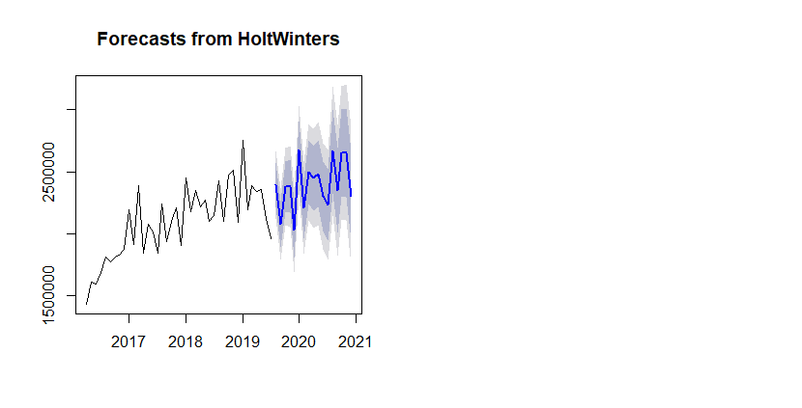
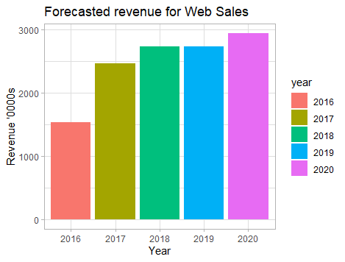
FORECASTS OF REVENUE FROM SALES THROUGH WEB
Revenue from sales through web show a gradual increase .
Average monthly Revenue(Aug 19-Dec 20):2.39m

Slide 23
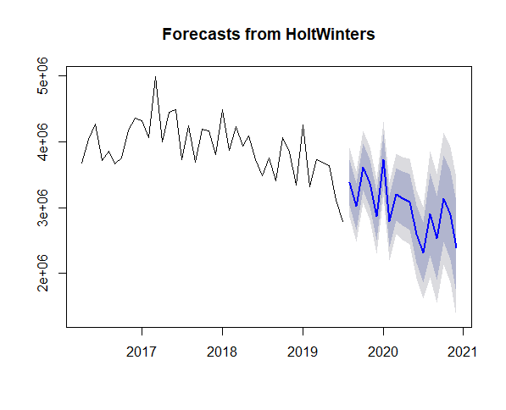
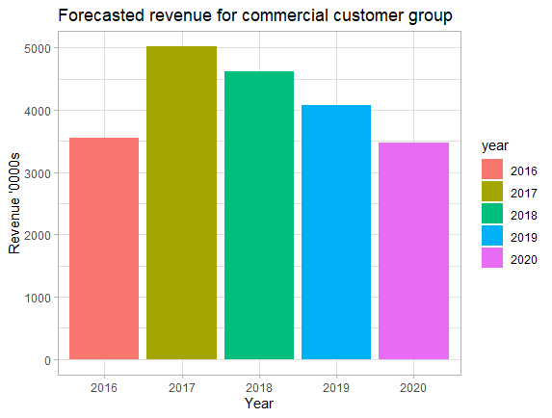
FORECASTS OF REVENUE FROM SALES THROUGH COMMERCIAL CUSTOMER GROUP
The business is also suffering a loss in revenue due to decrease in revenue from there commercial customer groups.
Average monthly Revenue(Aug 19-Dec 20):2.9m

Slide 24
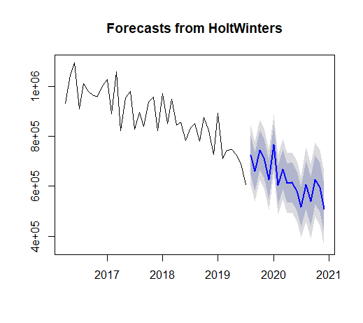
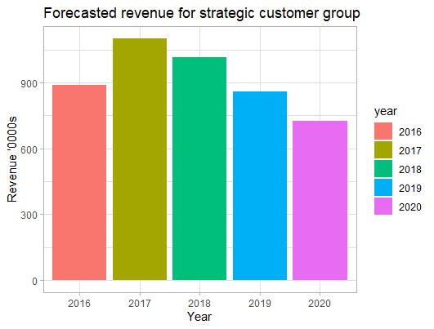
FORECASTS OF REVENUE FROM SALES THROUGH STRATEGIC CUSTOMER GROUP
Same can be seen for the customers belonging to strategic group.
Average monthly Revenue(Aug 19-Dec 20):0.63m

Slide 25
KEY INSIGHTS
The business may suffer a 25% loss in their total revenue from August 2019 to December 2020.
The highest contributors INK and CORE are also showing a decrease in the revenue generated through them in the coming time period . Loss due to Ink:16% ; Loss due to Core:18%
Inside sales have seen a steep fall in the revenue generated through them but this has not affected the total revenue in a large extent because it was compensated by sales through supply therefore the business’s main focus area should be to how gain back the revenue that is lost from inside sales.
Sales through supply have seen a sudden boom in end months of 2018 and in 2019 and is the 3rd largest contributor to revenue therefore business can focus on increasing sales through supply.
Sales through web have seen a gradual increase therefore the business should focus on online dealing as this may profit their business.15% Increase due to sales through web.
The company is losing revenue through there commercial as well as strategic customers therefore they should focus on how to regain them and also develop some new strategies. Loss due to commercial customers:23%; Loss due to commercial customers:29%

Slide 26
Thank You

